Slide 1
Windows Phone 7.5 Simplified
Danny Warren
@dannydwarren

Slide 2

LionHeart
Wireframes and Info Map
App Lifecycle
Page Navigation
Deactivation vs. Tombstoning
MVVM
Data Providers
Real vs. Mock
UI
Alignment
Styling
Future of Windows Phone

Slide 3
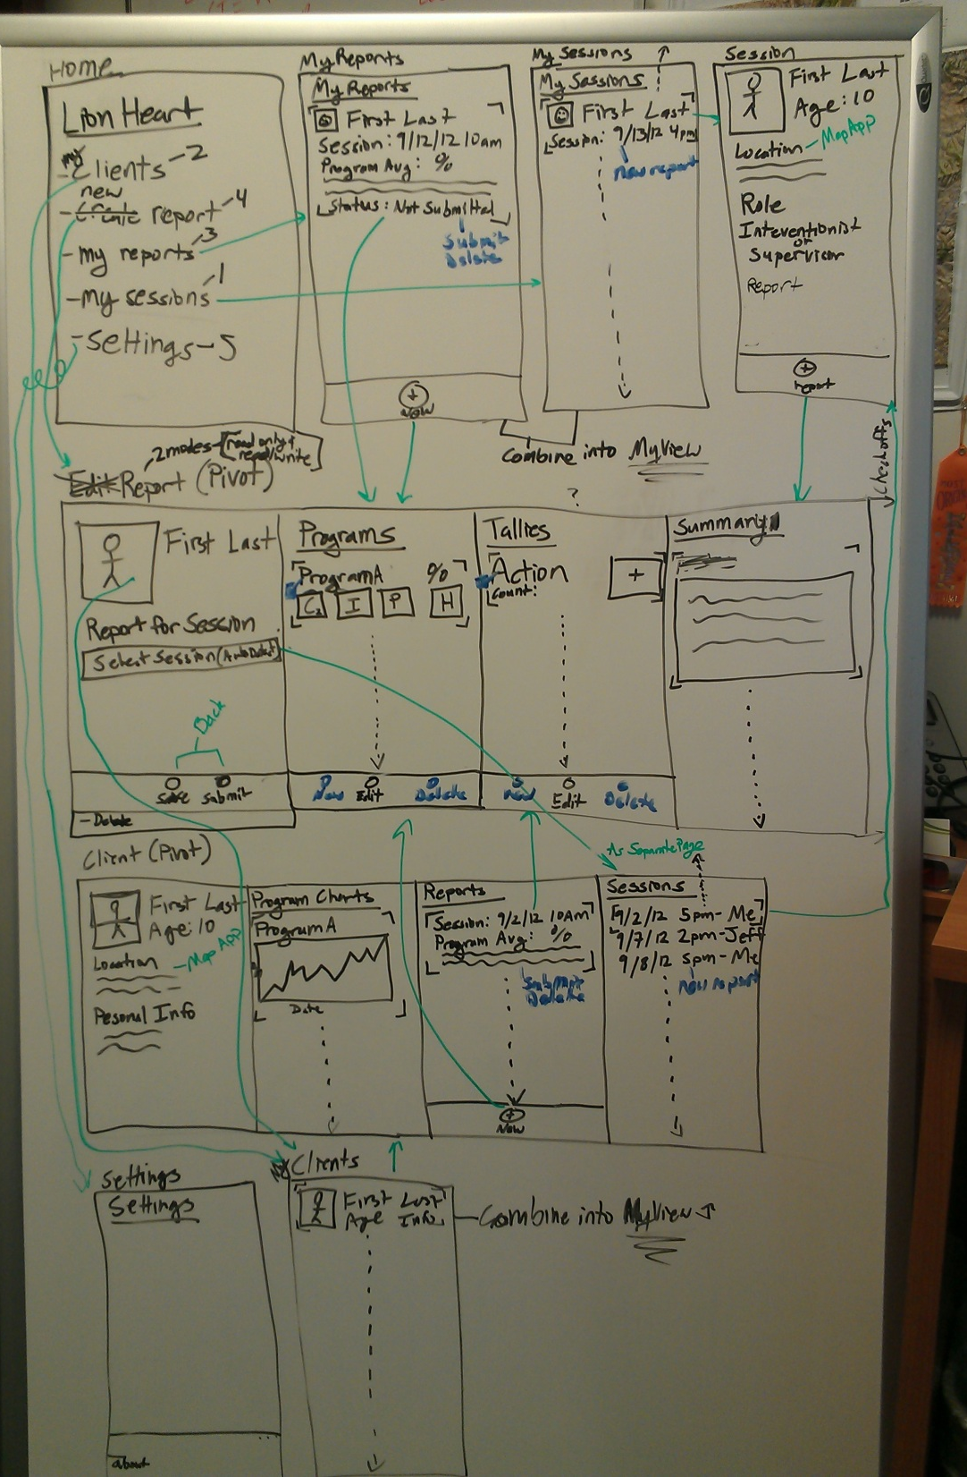
Wireframes and Information Map
START HERE!

Slide 4
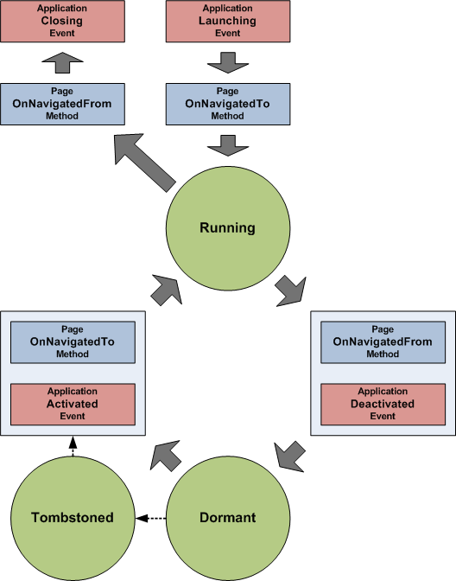
Lifecycle
http://msdn.microsoft.com/en-us/library/ff817008(v=vs.92).aspx

Slide 5
Future of Windows Phone
Windows Phone 8 (choice of APIs)
WinRT
Windows Phone 7.5 APIs
WinRT means shared codebase between Desktop, Tablet, and Phone!
Deeper OS integration
Cloud integration with Windows 8

Slide 6

End of Line
Danny Warren
@dannydwarren
dwarren@interknowlogy.com
Credentials
Neumont University (http://www.neumont.edu/) Bachelors in C.S.
www.interknowlogy.com
blogs.interknowlogy.com

